Slide 1

Immersed Tube Tunnel Project in IZMIR

Slide 2
Members
We are VOLTRAN

Slide 3
Content
General Overview
Ground Profile
Bridge
Artificial Island
Immersed Tube Tunnel

Slide 4
General Overview
1

Slide 5
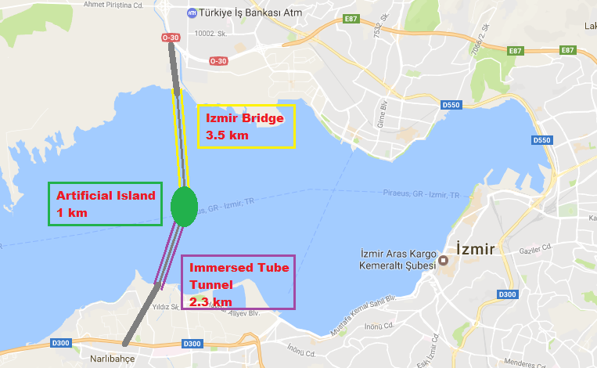

Slide 6
Wave height (m) |  |  | N | NW | W | SW | S | SE | E | NE
 | Winter | December | 2,0625 | 0,75 | 0,5 | 1,125 | 1,125 | 0,5 | 0,5 | 1,03125
 |  | January | 2,0625 | 0,75 | 0,5 | 1,125 | 1,125 | 0,5 | 0,5 | 1,03125
 |  | February | 2,0625 | 0,75 | 0,5 | 1,125 | 1,125 | 0,5 | 0,5 | 1,03125
 | Spring | March | 1,0 | 0,5625 | 0,5 | 1,125 | 1,125 | 0,5 | 0,5 | 0,7917
 |  | April | 1,0 | 0,5625 | 0,5 | 1,125 | 1,125 | 0,5 | 0,5 | 0,7917
 |  | May | 1,0 | 0,5625 | 0,5 | 1,125 | 1,125 | 0,5 | 0,5 | 0,7917
 | Summer | June | 1,5833 | 0,8611 | 0,5 | 0,5 | 0,5 | 0,5 | 0,5 | 0,5
 |  | July | 1,5833 | 0,8611 | 0,5 | 0,5 | 0,5 | 0,5 | 0,5 | 0,5
 |  | August | 1,5833 | 0,8611 | 0,5 | 0,5 | 0,5 | 0,5 | 0,5 | 0,5
 | Autumn | September | 1,5833 | 0,7083 | 0,5 | 0,5 | 0,5 | 0,5 | 0,5 | 0,7083
 |  | October | 1,5833 | 0,7083 | 0,5 | 0,5 | 0,5 | 0,5 | 0,5 | 0,7083
 |  | November | 1,5833 | 0,7083 | 0,5 | 0,5 | 0,5 | 0,5 | 0,5 | 0,7083
Wind speed (m/s) |  |  | N | NW | W | SW | S | SE | E | NE
 | Winter | December | 10,0 | 5,556 | 5,0 | 7,8125 | 7,8125 | 5,208 | 5,0 | 7,9375
 |  | January | 10,0 | 5,556 | 5,0 | 7,8125 | 7,8125 | 5,208 | 5,0 | 7,9375
 |  | February | 10,0 | 5,556 | 5,0 | 7,8125 | 7,8125 | 5,208 | 5,0 | 7,9375
 | Spring | March | 10,0 | 6,4931 | 5,0 | 6,111 | 6,667 | 5,556 | 5,0 | 6,875
 |  | April | 10,0 | 6,4931 | 5,0 | 6,111 | 6,667 | 5,556 | 5,0 | 6,875
 |  | May | 10,0 | 6,4931 | 5,0 | 6,111 | 6,667 | 5,556 | 5,0 | 6,875
 | Summer | June | 10,0 | 6,542 | 5,0 | 5,0 | 5,0 | 5,0 | 5,0 | 6,333
 |  | July | 10,0 | 6,542 | 5,0 | 5,0 | 5,0 | 5,0 | 5,0 | 6,333
 |  | August | 10,0 | 6,542 | 5,0 | 5,0 | 5,0 | 5,0 | 5,0 | 6,333
 | Autumn | September | 9,0 | 5,9375 | 5,0 | 5,764 | 6,667 | 5,208 | 5,0 | 6,875
 |  | October | 9,0 | 5,9375 | 5,0 | 5,764 | 6,667 | 5,208 | 5,0 | 6,875
 |  | November | 9,0 | 5,9375 | 5,0 | 5,764 | 6,667 | 5,208 | 5,0 | 6,875

Slide 7
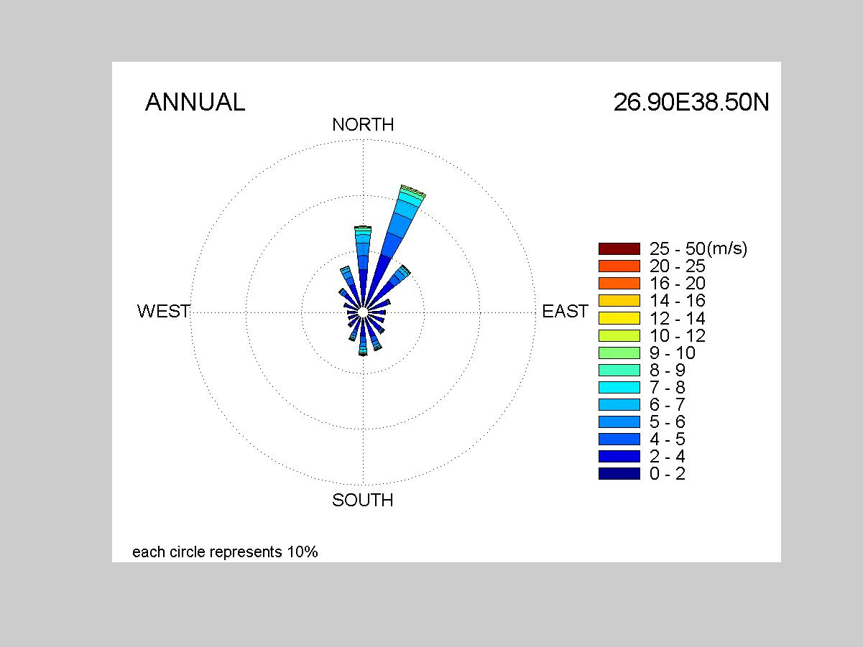

Slide 8
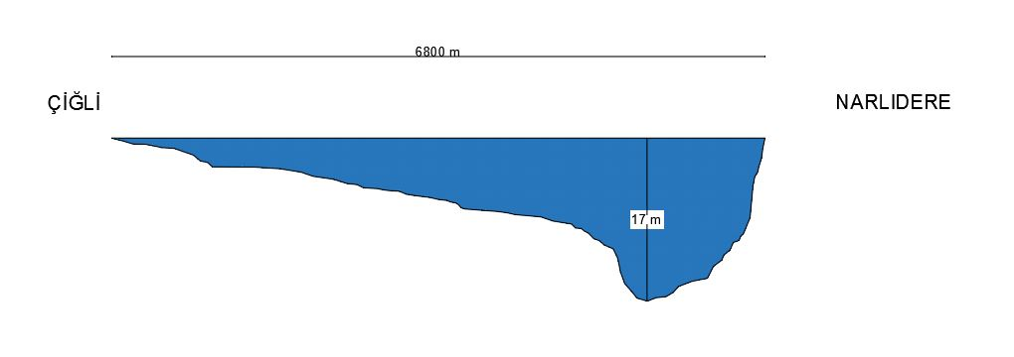
Bathymetry

Slide 9
 | Name | Material | Pos. Number | Unit Price (TL) | Unit | Quantity | Total (TL)
Foundation | Bridge Found. Excavation | - | KGM/14.224 | 98,8 | m³ | 1920 | 189696
 | Wide Excavation (Tunnel) | - | 14.012/1 | 34,69 | m³ | 4000000 | 138760000
 | Bridge Piles | Concrete | Y.16.050/05 | 165,03 | m³ | 8000 | 1320240
 | Tunnel Piles | Concrete | Y.16.050/05 | 165,03 | m³ | 1100 | 181533
Bridge | Piers | Concrete | Y.16.050/05 | 165,03 | m³ | 40320 | 6654009,6
 | Pylons | Concrete | Y.16.050/05 | 165,03 | m³ | 5780 | 953873,4
 | Deck Girders | Steel | Y.23.101 | 3428,64 | ton | 7693 | 26376527,52
 | Deck Box | Steel | Y.23.101 | 3428,64 | ton | 85000 | 291434400
 | Cables | Steel | 1140/1 | 15,17 | m | 3800 | 57646
Artificial Island | Rubble Mound | Rock | 17.084 | 82,96 | m³ | 133750 | 11095900
 | Underlayer of Island | Stone | 17.081 | 49,43 | m³ | 44600 | 2204578
 | Filling for Island | Sand | 15.151/1 | 20,61 | m³ | 8000000 | 164880000
 | Primary Breakwater Rubble Mound | Rock | 17.084 | 82,96 | m³ | 7900 | 655384
 | Secondary Breakwater Rubble Mound | Stone | 17.081 | 49,43 | m³ | 1300 | 64259
 | Primary Breakwater Underlayer | Stone | 17.081 | 49,43 | m³ | 9800 | 484414
 | Secondary Breakwater Underlayer | Stone | 15.151/1 | 20,61 | m³ | 3100 | 63891
Tunnel | Tunnel Mold | Concrete | Y.16.050/05 | 165,03 | m³ | 592700 | 97813281
 | Backfilling & Bedding | Gravel | 15.151/1 | 20,61 | m³ | 1990000 | 41013900
Highway & Railway | Highway | Asphalt | KGM/6306/S | 8,18 | m² | 180000 | 1472400
 | Railway Base | Gravel | 15.140/4 | 6,3 | m³ | 7200 | 45360
 | Railway | Wood Sleepers | 35.004 | 12,72 | m | 7200 | 91584
 |  |  |  |  |  | Total | 785812876.5

Slide 10
With 2016 estimation rate
With inflation data
With Unexpected Costs
790 million TL
840 million TL
1 billion TL

Slide 11
Ground Profile
2

Slide 12
Soil Profile

Slide 13
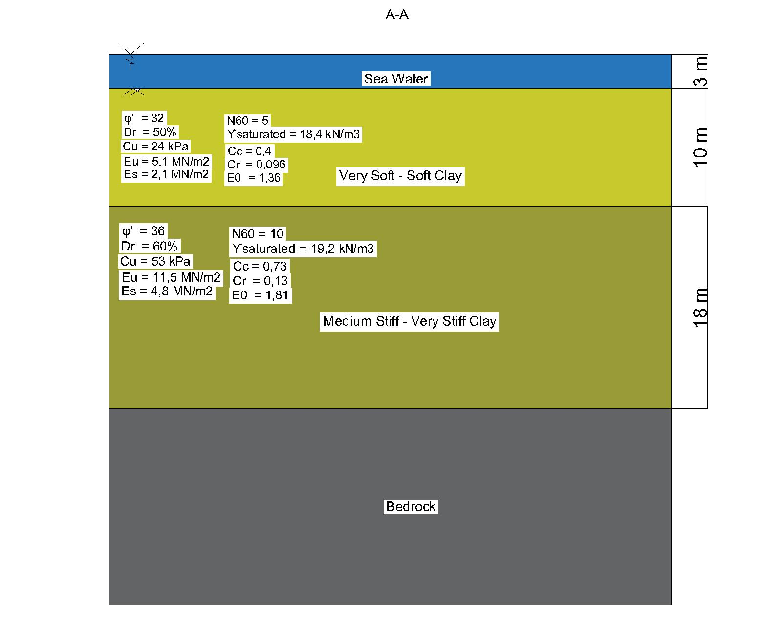
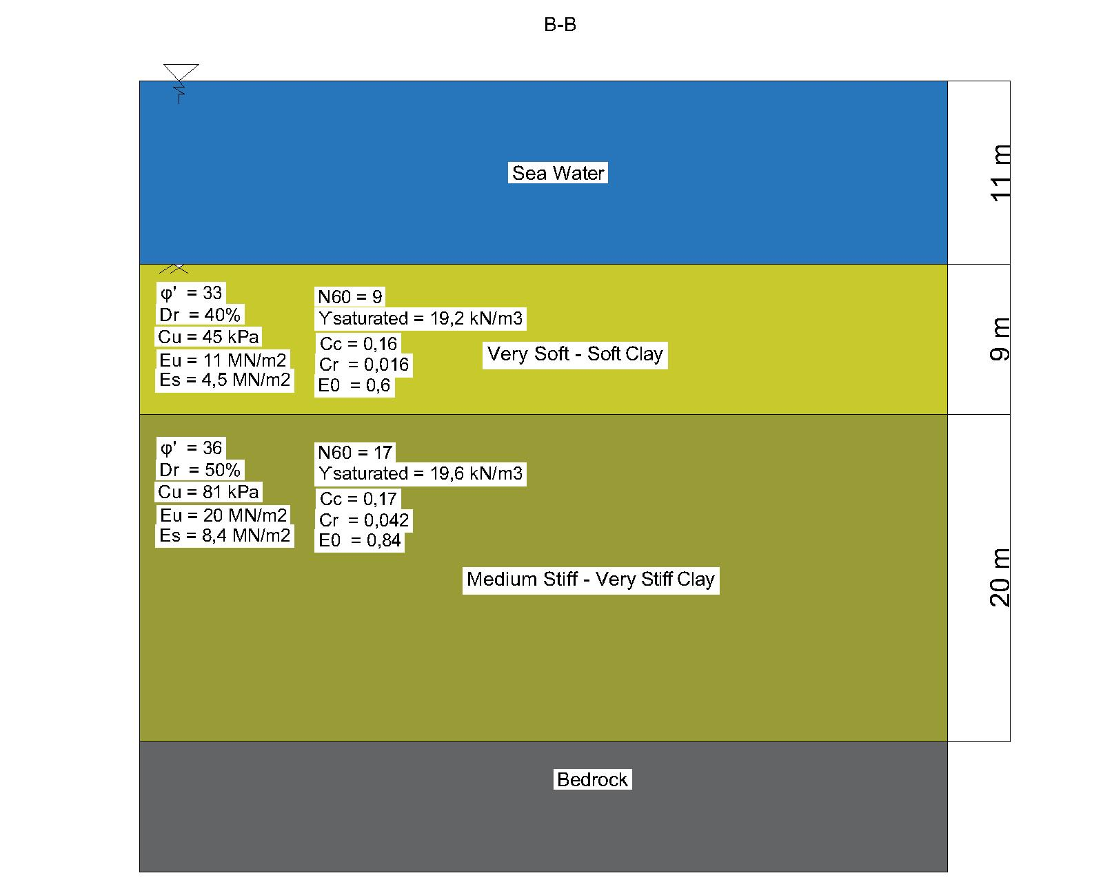
Soil Parameters

Slide 14
Soil Parameters
A-A
B-B

Slide 15
2,639,389 m³
1,656,000 m³
Volume of Dredged Soil
Volume of Fill Dirt

Slide 16
Bridge
3

Slide 17
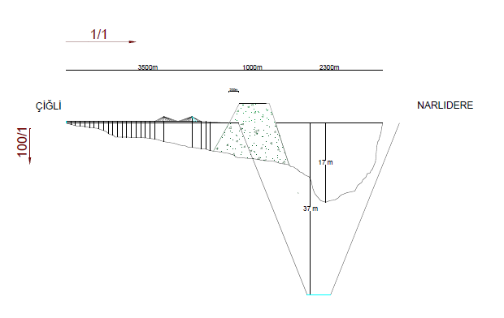
The Route

Slide 18
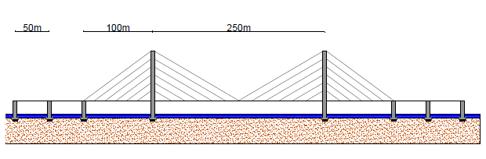
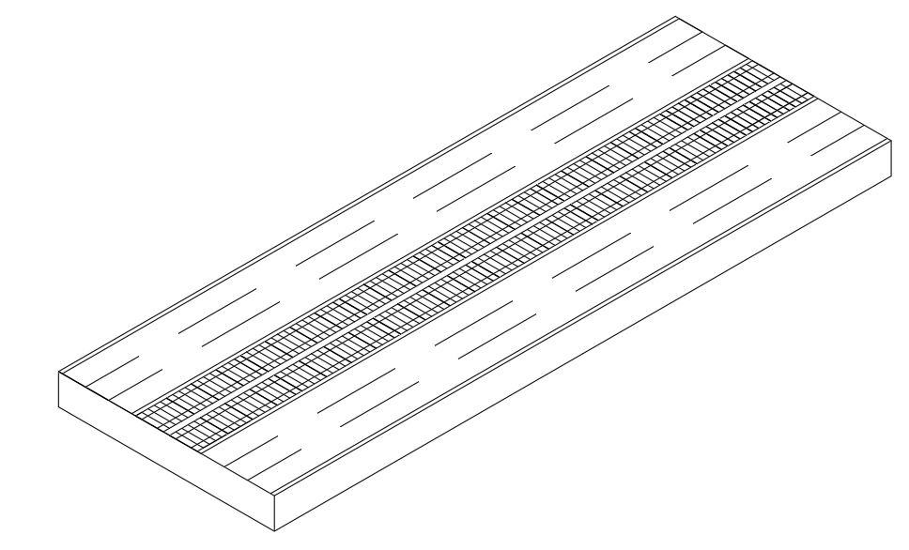
Leg Spans & Highway

Slide 19
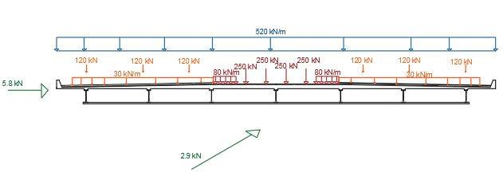

Slide 20
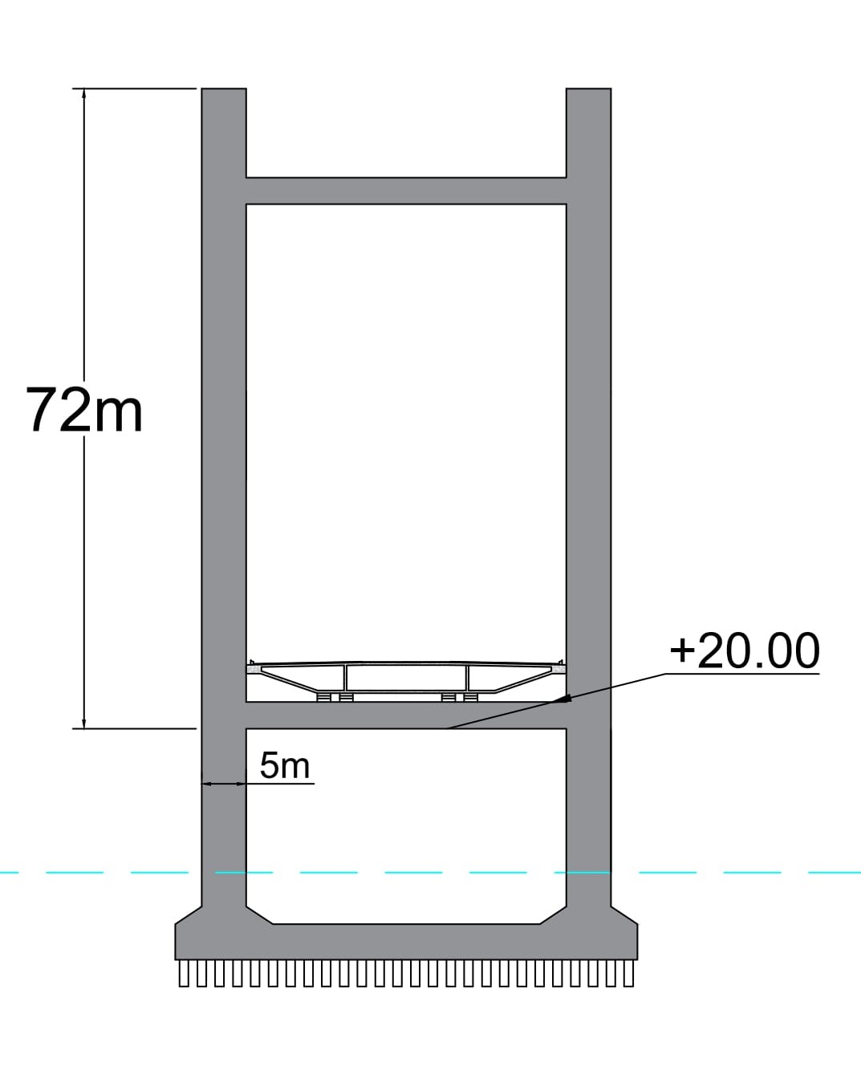
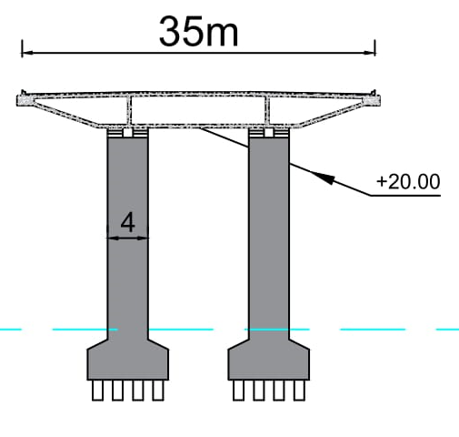
Pier Sections

Slide 21
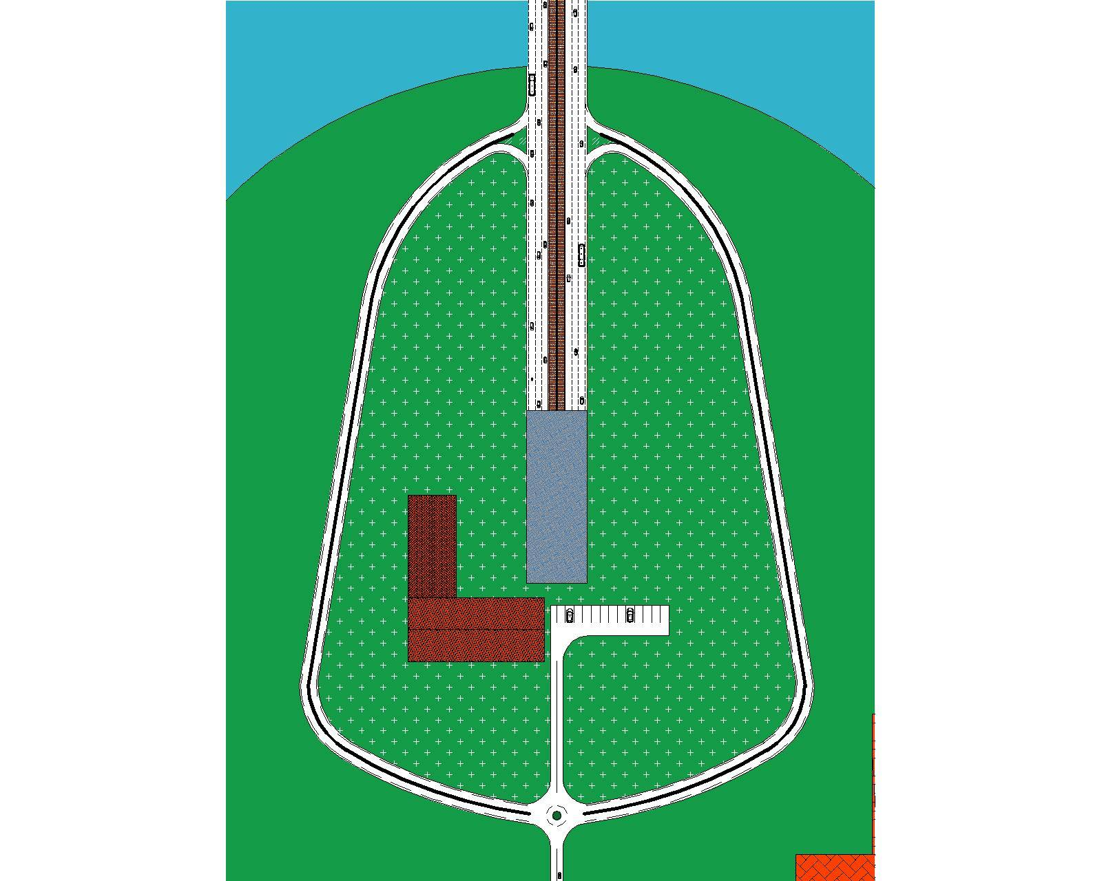

Slide 22
Artifical Island
4

Slide 23
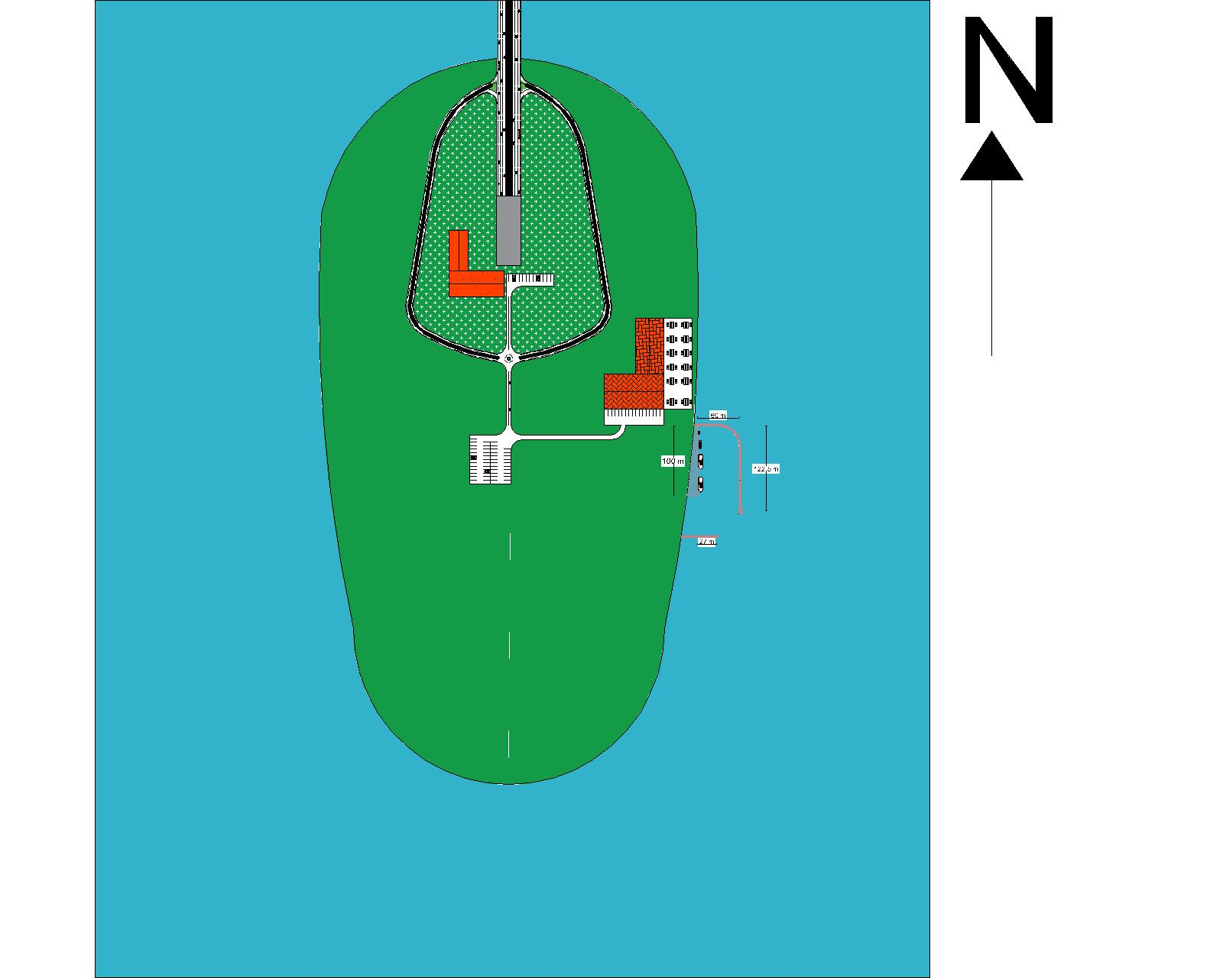
Design of Artificial Island
N

Slide 24
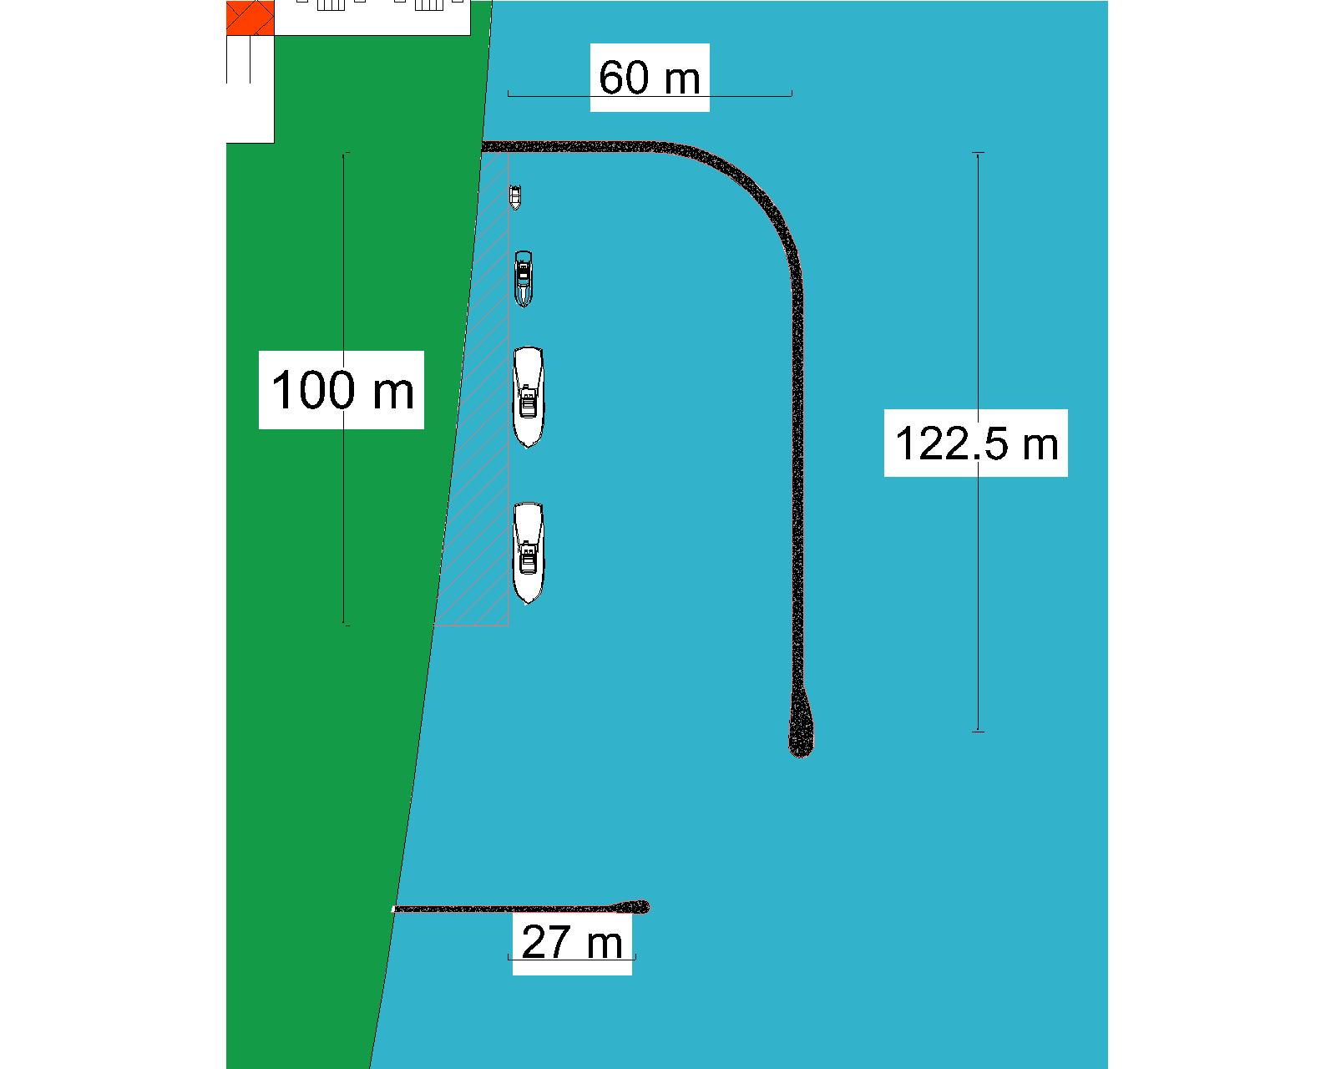
Design of Artificial Island

Slide 25
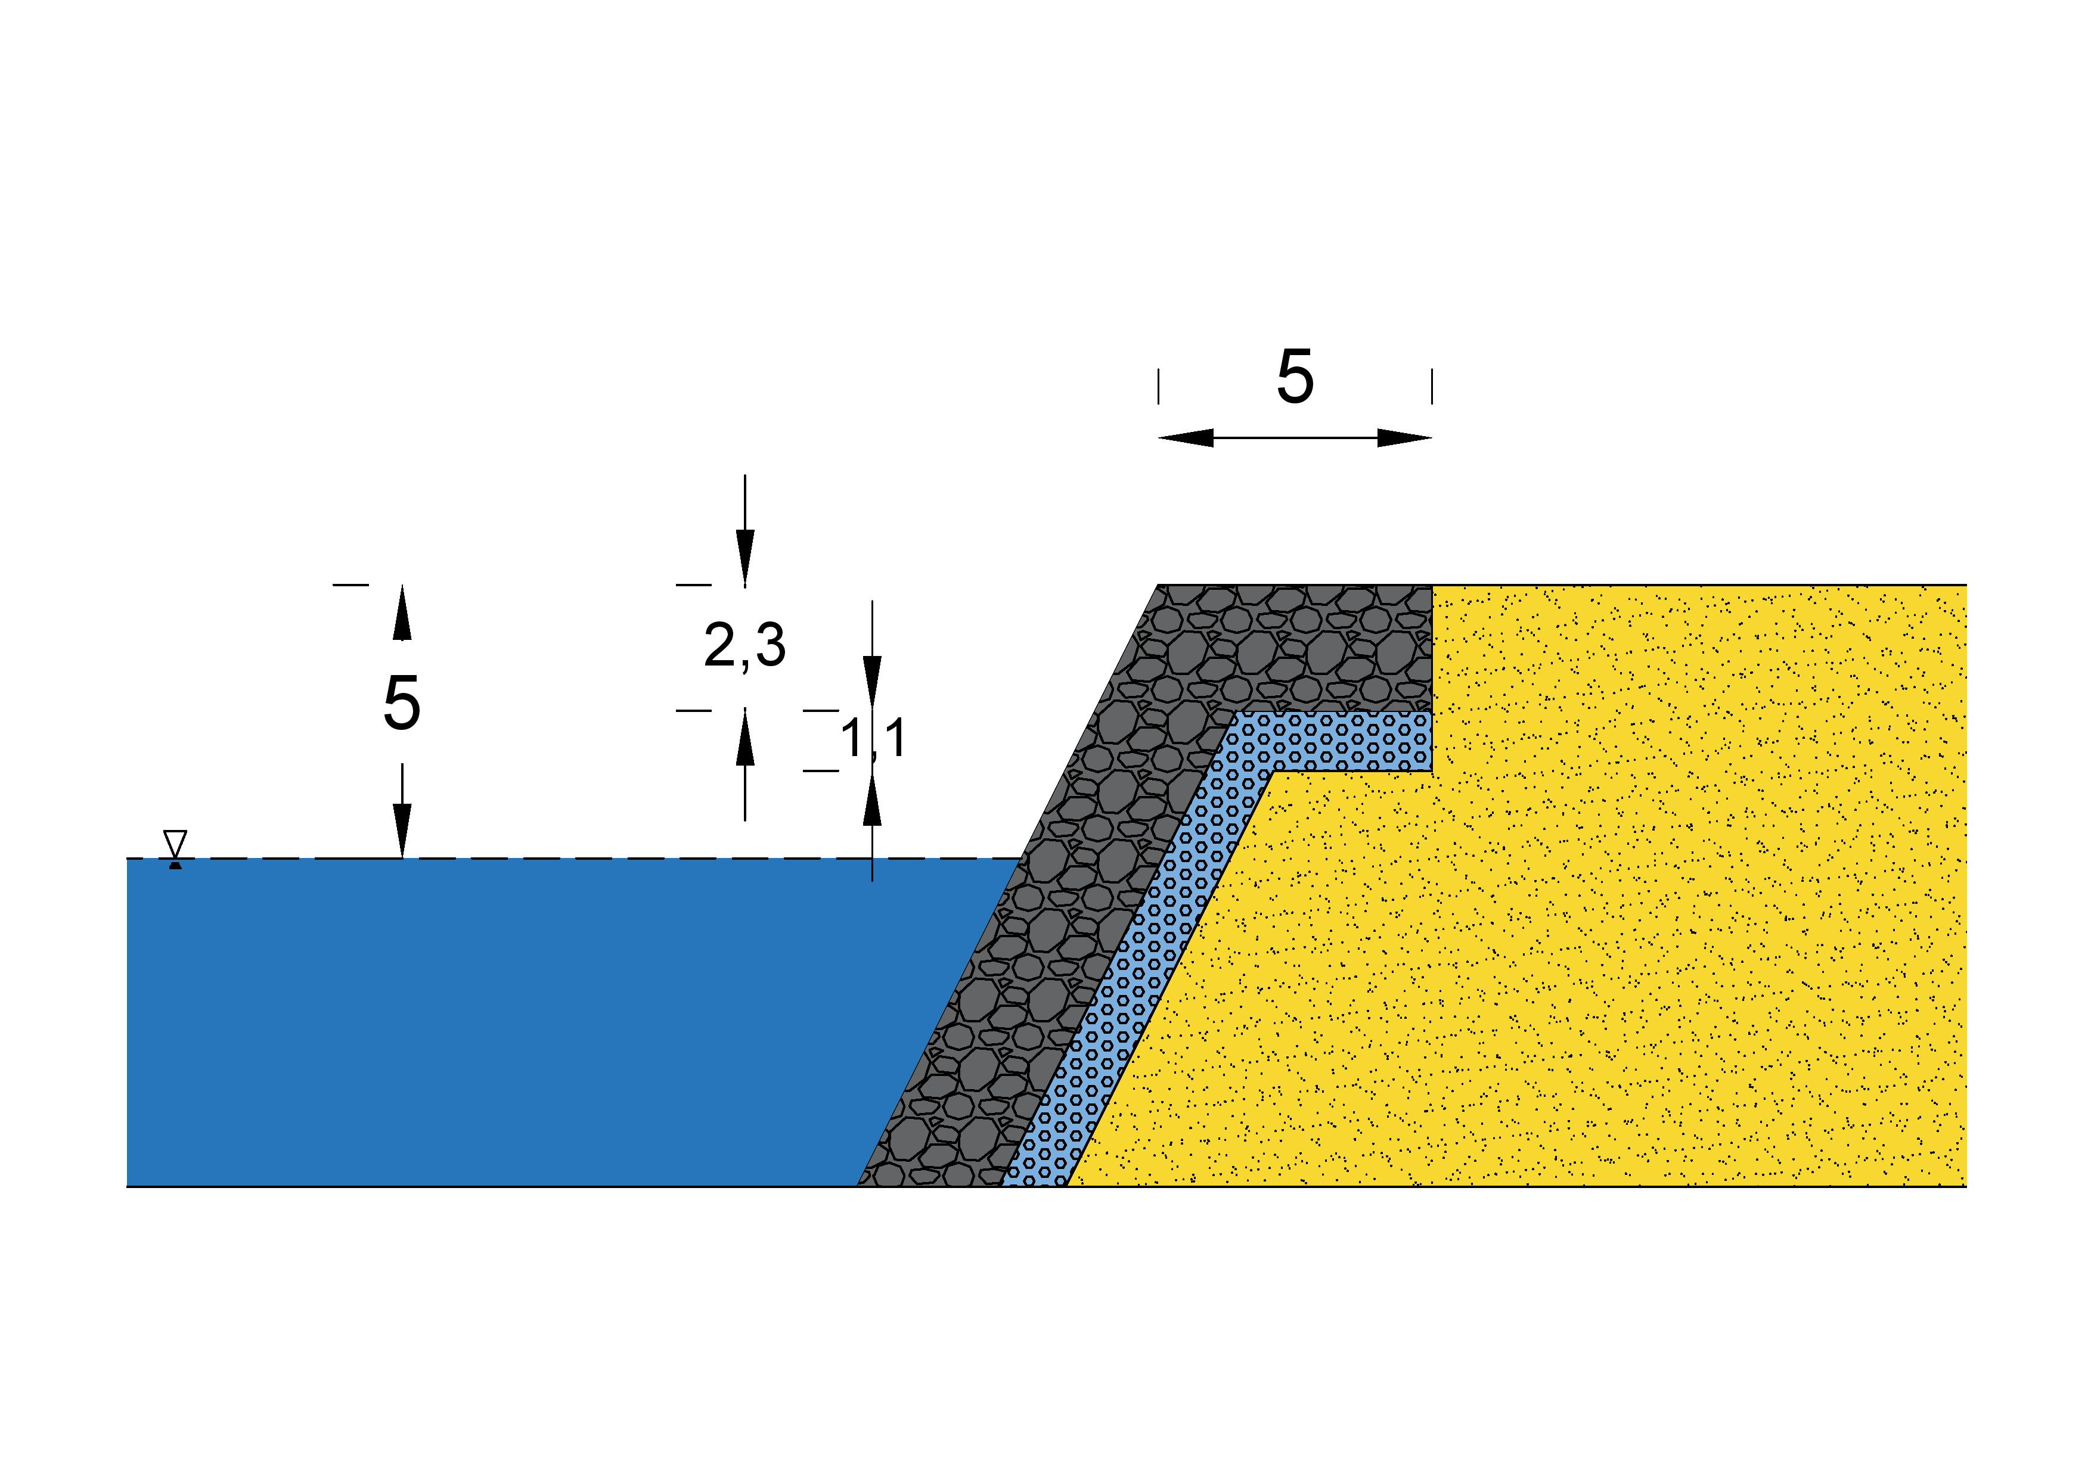
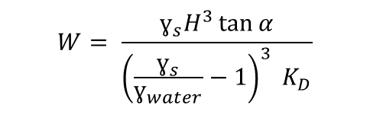
Layers of Artificial Island
According to Hudson Formula;
$$W= \frac{ɣ_{s}H^{3}\tan{α}}{{\left(\frac{ɣ_{s}}{ɣ_{water}}−1\right)}^{3} K_{D}}$$
Armour Layer : 3,6 Tons
Underlayer : 0,36 Tons

Slide 26
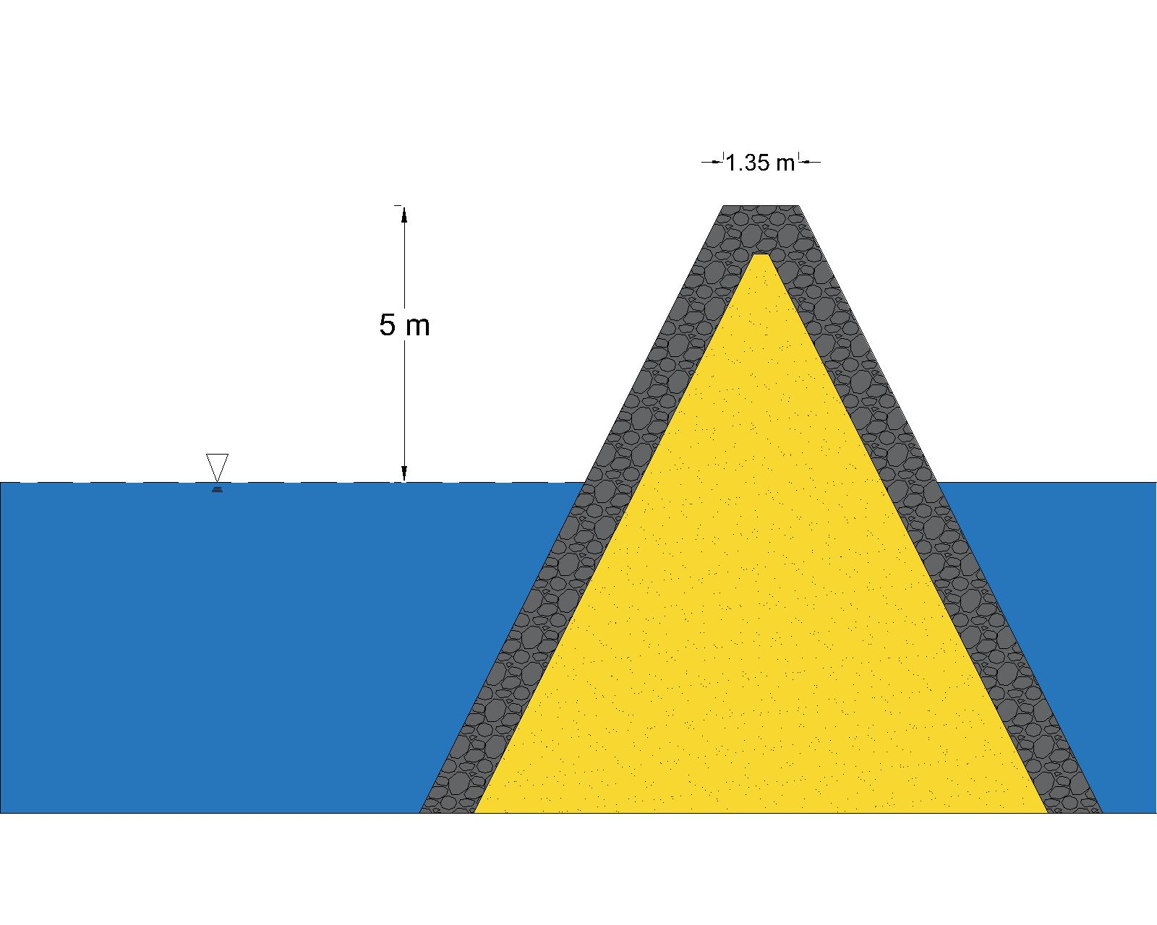
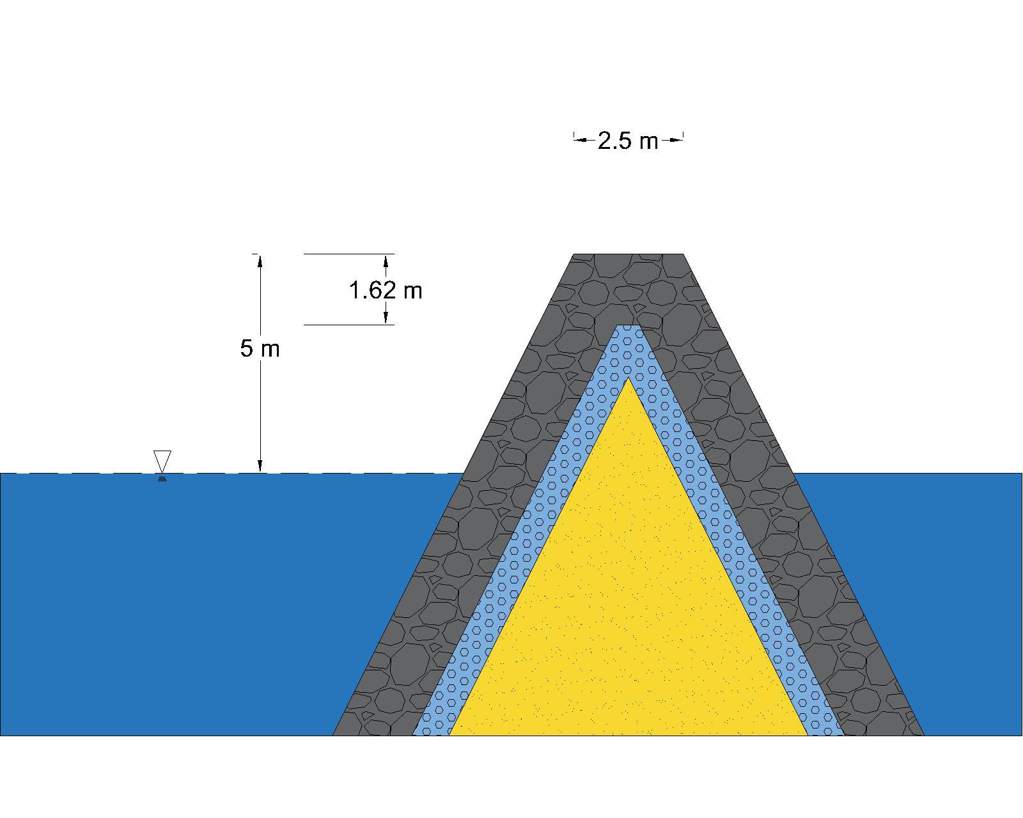
Layers of Artificial Island Marine
Head Layer : 1,6 tons
Armour Layer : 1,3 Tons
Underlayer : 0,13 Tons
Head Layer : 0,27 Tons
Armour Layer : 0,21 Tons

Slide 27
11,443,000 m³
133,750 m³
Volume of Core
Volume of Armour Layer
44,600 m³
Volume of Underlayer

Slide 28
Immersed Tube Tunnel
5

Slide 29
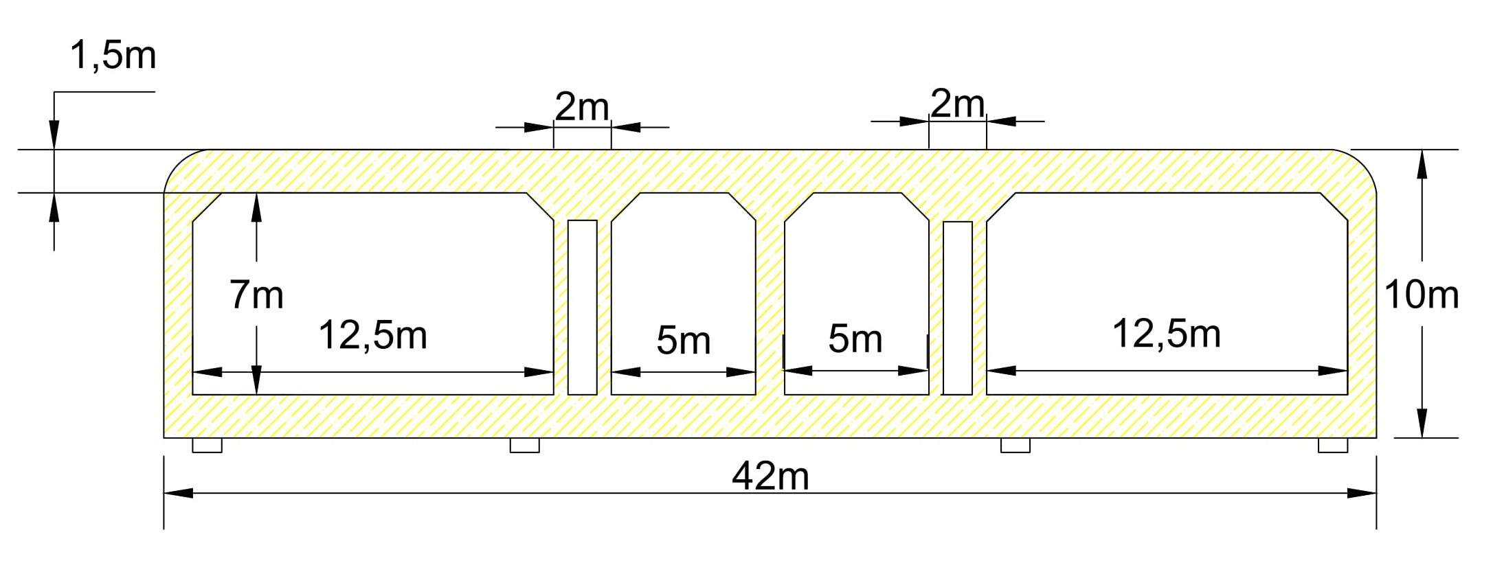
Properties of Tube Tunnel
Rectangular
Reinforced Concrete ( C30 )
Ventilation Rooms

Slide 30
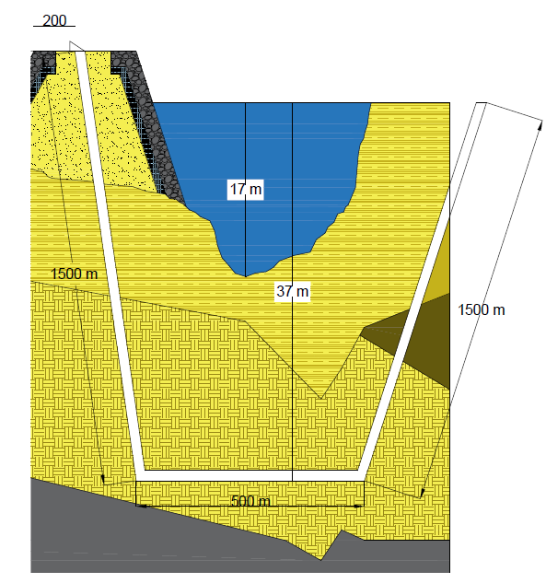
Design Process
Planned Location
m
A
A

Slide 31
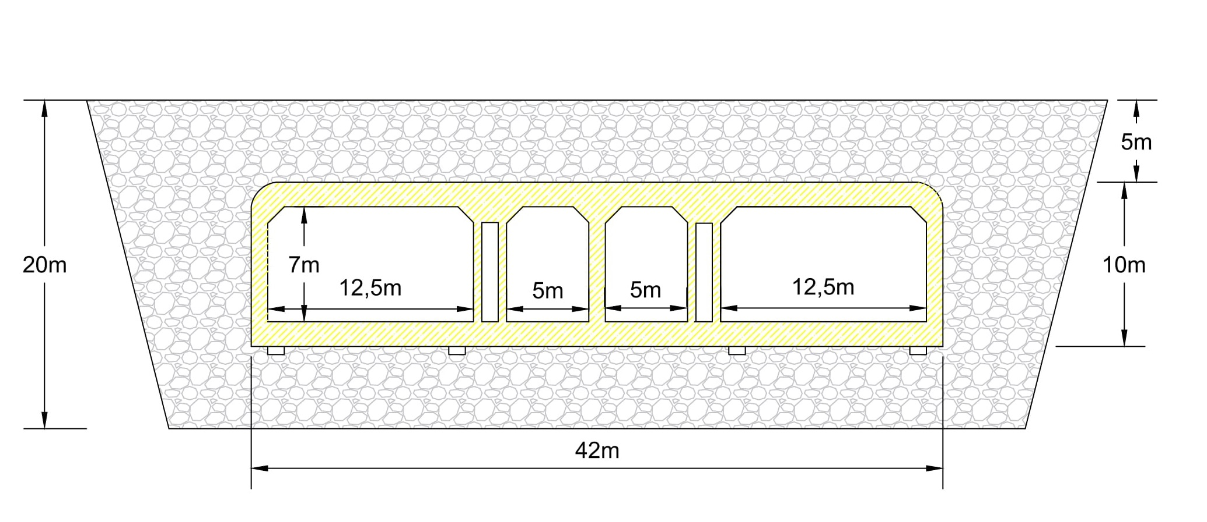
A-A Section
Bedding Layer,
Backfilled and Armor Layer

Slide 32
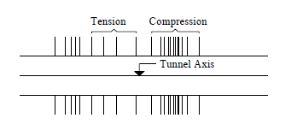
Seismic Analysis Procedure
Axial and Lateral Forces
Allowable Design Stress and Strain
Rubber Seal
Retrieved From PRELIMINARY DESIGN AND ANALYSISFOR AN IMMERSED TUBE TUNNEL ACROSS THE İZMİR BAY

Slide 33
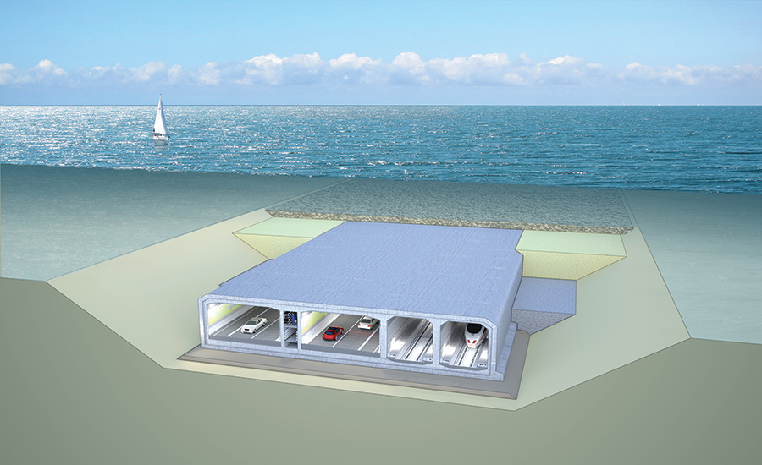
Construction Procedures
Prefabrication
Immersion Operation,
Seated on the Foundation
Retrieved from http://www.railsystem.net/immersed-tube-tunnel/

Slide 34
References
Erol, O., & Çekinmez, Z. (2014). “Geoteknik Mühendisliğinde Saha Deneyleri”. Retrieved March 20, 2017
İzmir Körfezi ve Limanı Rehabilitasyon Projesi (İzmir İli, Konak İlçesi) Çevresel Etki Değerlendirmesi Raporu. (2016). Retrieved March 21, 2017
İzmir Körfezi ve Limanı Rehabilitasyon Projesi Liman Yaklaşım Kanalı, Manevra Dairesi, Liman Baseni,II. Kısım Konteynır Sahası ve Sirkülasyon Alanı Jeoteknik Raporu. (2013). 1-2. Retrieved March 20, 2017.
Körfez Yeniden Hayat Buluyor. (n.d.). Retrieved March 21, 2017, from http://www.izsu.gov.tr/Pages/standartPage.aspx?id=208
M.J. Tomlinson, Foundation Design and Construction, Pitman Books Ltd, London,1980,p.659 (Deniz Yapılarında Beton Üretim Teknikleri,Prof.Dr M.Süheyl AKMAN,, İTÜ İnş. Fak.)
N.Kartaltepe (2008).Preliminary Design anf Analysis For an Immersed Tube Tunnel Across The Izmir Bay. Retrieved from http://library.iyte.edu.tr/tezler/master/insaatmuh/T000768.pdf

Slide 35
References
Non-Conventional Rubble Mound Breakwater with Core made of Geotextile Sand Containers (Geocore Breakwater). (n.d.). Retrieved March 21, 2017, from https://www.tu- braunschweig.de/lwi/hyku/forschung/abgeschlosseneprojekte/geocore
Yılmaz, M. (2017, March 06). Bürokrasi, İzmir'e milyarları kaybettirdi | Mustafa Yılmaz. Retrieved March 21, 2017, from http://www.milliyet.com.tr/burokrasi-izmir-e-milyarlari-/mustafa- yilmaz/ege/yazardetay/06.03.2017/2408106/default.htm
http://www.kgm.gov.tr/
https://www.tmmob.org.tr/

Slide 36
Thank you for your attention!
Is there any question?

